Slide 1


Netnod
EPF 2026 Update
Karin Ahl,
CEO Netnod
Notes:
Good morning everyone and welcome to Paris. I'm Karin Ahl, CEO of Netnod, and it's my pleasure to welcome you all to the EPF.

Slide 2

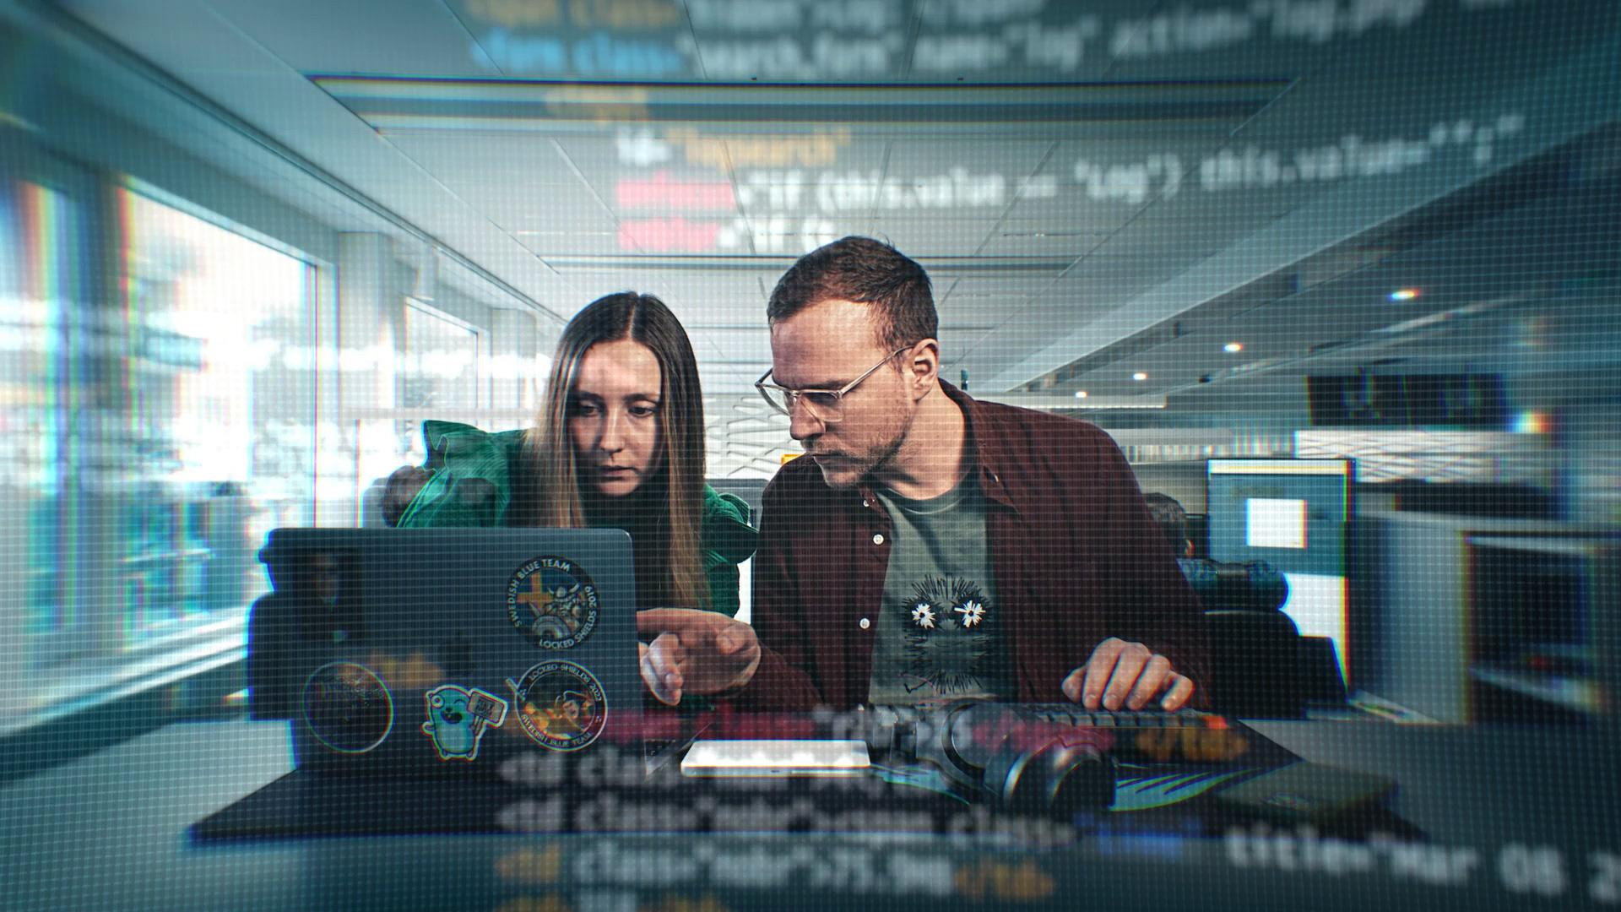
We are
Netnod
Rooted in Sweden, strengthening the world.
Founded in 1996 as a neutral and independent organisation working for a robust Internet through technical development and knowledge sharing.
30
+50
24/7
3+
Years
FTEs
Support
Tbps peak traffic
Notes:
This year's theme is "Connecting Europe's Peering Community". This is particularly fitting for Netnod with 2026 marking 30 years since we were founded as the neutral Internet Exchange for Sweden.
Since then, we have grown into the interconnection platform for the Nordics with peak traffic exceeding 3 Terabits per second across seven Exchanges in Sweden, Denmark, Norway and Finland.
Our growth has been built on two elements that are even more important today than 30 years ago: trust and resilience.

Slide 3
The ground beneath us is shifting
Traffic & Investment
New technologies driving traffic growth and investment across infrastructures.
Geopolitical Pressure
Tensions put resilience and sovereignty at the centre of Europe's digital agenda.
Regional Resilience
Recent events in our region have shown why resilience matters more than ever.
Proactive Security
Redundancy, diverse routes and proactive monitoring ensure continuity.
Notes:
Because the ground beneath our feet is shifting fast.
New technologies are driving traffic growth and investment, while geopolitical tensions are putting resilience and sovereignty at the centre of Europe's digital agenda. Recent events in our region have shown why resilience matters more than ever.
At Netnod, resilience has been at the heart of our approach for 30 years. This means multiple layers of redundancy, diverse connections, proactive monitoring, and infrastructure designed to be robust and reliable.
That commitment to resilience runs through Netnod: from how we design our Internet Exchanges to how we think about our responsibility to the Internet and society as a whole. And as tensions rise and the threat landscape evolves, resilience means continuing to invest and adapt.

Slide 4
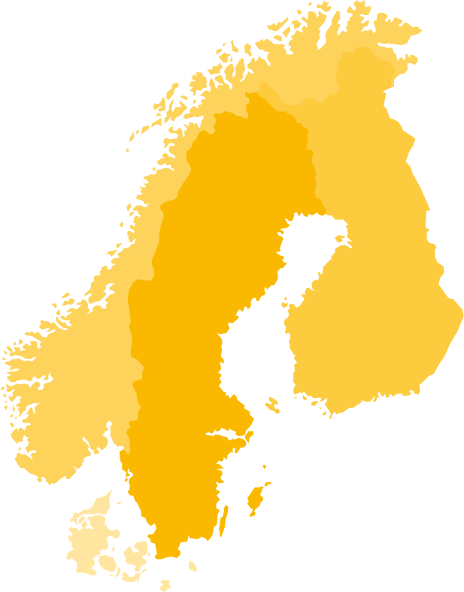
Driving resilience in the Nordics
Evolving services to help networks grow and scale resiliently
Testing resilience at NATO's Locked Shields 2026
Building our own regional DWDM ring
Luleå
Luleå
Sundsvall/Gävle
Sundsvall/Gävle
Helsinki
Helsinki
Oslo
Stockholm
Gothenburg
Copenhagen/Malmö
Notes:
That's why we've focused on driving change — evolving our services to help networks grow and scale resiliently. We're providing more flexible ways to connect, supporting everything from local peering and private connectivity to remote peering, cloud connectivity and time services.
That's why our experts took part in NATO's Locked Shields 2026, testing resilience alongside thousands of security experts from across the world.
And that's why we are building our own regional DWDM ring, connecting Stockholm, Gothenburg, Oslo, Copenhagen, and Malmö. By taking direct control of our optical infrastructure, we can reduce dependencies, develop new services for our customers, and help make the Nordic Internet more resilient.

Slide 5
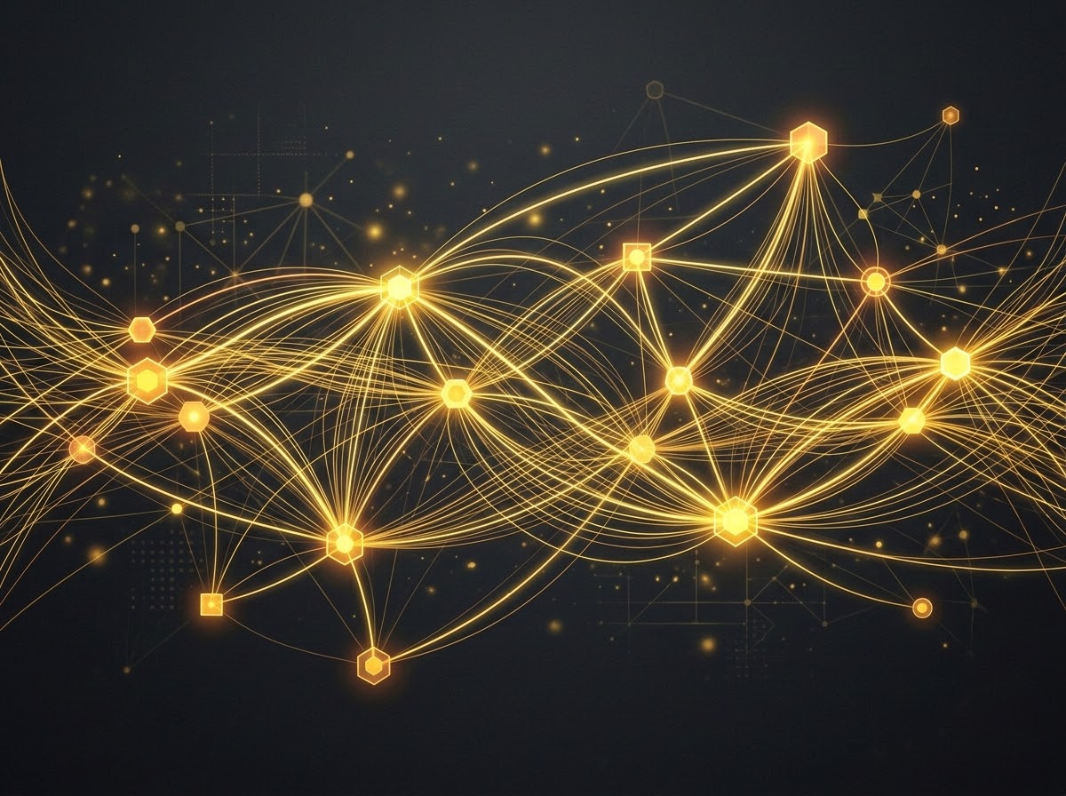
Alliances
Swedish Security & Defence
Joined the Swedish Security and Defence Industry Association
Digital Networks Act
Joined a coalition calling for the Digital Networks Act to protect net neutrality and the open Internet
RIPE NCC Board
Co-founder Lars-Johan Liman elected to the RIPE NCC Executive Board
Notes:
Resilience also means building new partnerships. We joined the Swedish Security and Defence Industry Association, reflecting how closely critical infrastructure and national security are now connected. We also joined a coalition of operators calling for the Digital Networks Act to protect net neutrality and the open Internet on which peering depends.
And we were honoured to see Netnod's co-founder, Lars-Johan Liman, elected to the RIPE NCC Executive Board, a recognition of his expertise, and of the trust that the technical community places in people who have spent decades contributing to it.
These may be different arenas, but they reflect the same principle: resilience develops through commitment, cooperation and community.

Slide 6
Because
the Internet isn't built by infrastructure alone. It's built by people.
Welcome to EPF 2026.
Notes:
For Netnod, resilience has always been about more than infrastructure. It's about bringing together the people behind the infrastructure. That community is growing — from the peering community here at the EPF, to experts in cybersecurity, defence, policy and Internet governance.
Netnod is proud to play an important role in connecting those worlds: strengthening the relationships, sharing the expertise and building the trust that make the Internet more resilient.
Because ultimately, the Internet isn't built by infrastructure alone. It's built by people.
And that is why the European Peering Forum so important. You are the people who build our Internet.
So, on behalf of Netnod and our fellow EPF hosts: thank you for being here and thank you for the work you do. Let's keep building the relationships, trust and cooperation that the Internet, and our societies, depend on. Welcome to the EPF 2026.

